Slide 1







Practical Teamwork
Course Overview
Teamwork
Course
SoftUni Team
Technical Trainers
Software University
http://softuni.bg

Slide 2

Table of Contents
Course Objectives
Course Program
Trainers Team
Course Schedule
Evaluation
Learning Resources

Slide 3
Have a Question?
sli.do #softuni-teamwork

Slide 4







SoftUni Diamond Partners

Slide 5


Practical Teamwork @ SoftUni
Teamwork
Additional Training

Slide 6


Practical Teamwork Course Goals
3 Months Training
Gain additional skills for working in a team
Part I
Lectures and Exercises on specific skills
Submit your homework to advance
Part II
Develop a practical project
Demonstrate your work live at SoftUni

Slide 7
Course Timeline
Lectures
Final Assignment
Defense
11. October
25. October
8. November
22. November
29. November
13. January
14. January
The schedule allows you to study for your exams

Slide 8

Practical Teamwork
Course Objectives & Program

Slide 9

Course Objectives
The Practical Teamwork course provides
Technical, organizational and personal skills for working in a team environment
Guidelines for analyzing project requirements
Practical introduction to web frameworks
Presentation skills

Slide 10

Course Topics
Source Control Systems
Git & GitHub, IDE integration
Project Requirements and UI Prototyping
Creating a UI prototype from requirements
Task Management Tools
Trello, Kanban, etc.

Slide 11

The Trainers Team

Slide 12
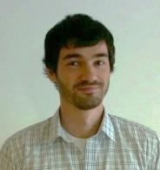
Trainers Team
Peter Penev
Technical Trainer @ Software University
Top performing student from the Software University
Deep interest in Data Structures & Algorithms

Slide 13
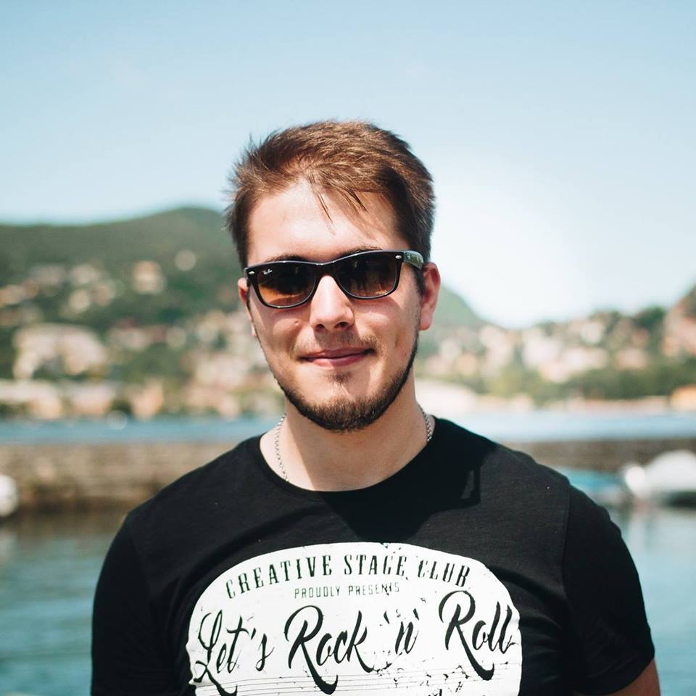
Trainers Team (2)
Ivaylo Zhelev
Graduated as Top Student from SoftUni
Training Team Leader at SoftUni
Exceptionally creative, loves making exams
Interested mainly in Game Development

Slide 14
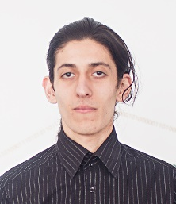
Trainers Team (3)
Simeon Sheytanov
Training Team Lead at Software University
Top performing student from the Software University
Programming experience with C#, Java, C++, Python, JavaScript, PHP, VB, Assembler and other programming languages
Interested in game development

Slide 15
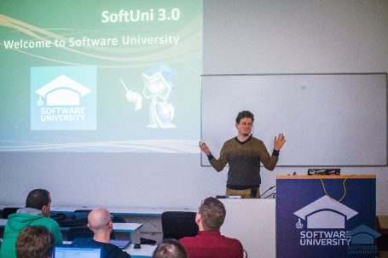


Practical Teamwork
Course Details and Schedule

Slide 16
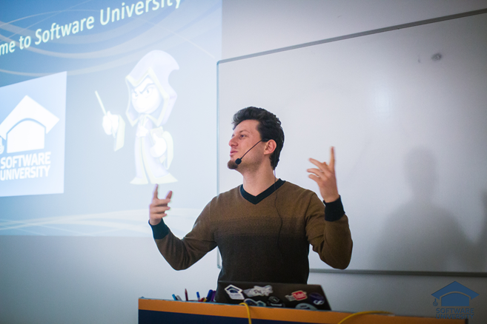
Training Duration and Schedule
Lessons: ~ 10 hours (onsite + YouTube videos)
Homework: ~ 0-10 hours
Lectures time frame
11-Oct-2017 – 8-Nov-2017
Final defense
13-Jan-2018
14-Jan-2018

Slide 17


Why English?
Why are the slides in English?
English is the native language of the software engineers
Specific terminology should be in English
Translations are inaccurate and funny
Just learn English!
No excuses

Slide 18

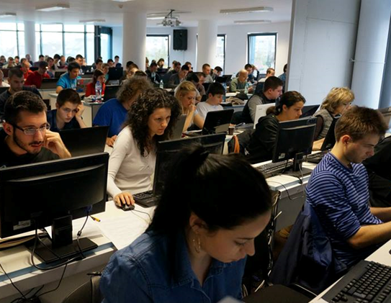
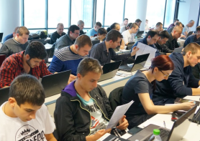
Practical Teamwork
Evaluation Criteria

Slide 19
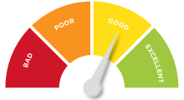

Scoring System for the Course
Assignment:
Overall Quality – 25%
Teamwork – 50%
Presentation – 25%
Bonuses:
Extra credit – 10%

Slide 20


Homework Assignments & Exercises
During every Lecture day, an assignment will be given out
Complete the assignment with your teammates to advance to the next stage
Only students who completed all assignments will be eligible for the final project!

Slide 21
Project Details
Design and implement a Web Application
Develop your own back-end service
Use JavaScript, HTML and CSS
Communicate via REST services
Write well-structured code!
Organize your team
Chose a Project Manager
Use source control and task management tools

Slide 22
Project Assignment
Your team has to agree on a topic and create their own assignment
Consult the trainers’ team for advice on requirement and scope
List of sample ideas will be provided

Slide 23










Resources
What We Need Additionally?

Slide 24

The Programming Basics Slides and Videos
All lecture slides, videos, homework assignments, projects and other resources are open content, available for free
Visit the course web site to access the course resources:
https://softuni.bg/trainings/1799/practical-teamwork-sept-2017

Slide 25
Practical Teamwork – Course Overview
https://softuni.bg/courses/practical-teamwork

Slide 26

License
This course (slides, examples, demos, videos, homework, etc.) is licensed under the "Creative Commons Attribution-NonCommercial-ShareAlike 4.0 International" license

Slide 27





Trainings @ Software University (SoftUni)
Software University – High-Quality Education, Profession and Job for Software Developers
softuni.bg
Software University Foundation
http://softuni.foundation/
Software University @ Facebook
facebook.com/SoftwareUniversity
Software University Forums
forum.softuni.bg

